Slide 1

Hadoob Ecosystem
Spring 2026
Dr Mayada Hadhoud

Slide 2
outline
Introduction
Hadoop Ecosystem Components
Big Data Architecture Layers vs. Hadoop Ecosystem
Hadoop Distributed File System (HDFS)
HDFS Storage Concepts
HDFS Architecture
HDFS Dataflow
Hdfs Reliability & Scalability
When HDFS Is Not the Right Choice

Slide 3
Introduction
Hadoop is an open-source Big Data framework for storing and processing large-scale data across distributed clusters using commodity hardware.
Designed to:
Store massive datasets
On clusters of low-cost machines
Using distributed storage and computing
Provides:
Distributed file storage (HDFS)
Distributed data processing
Hadoop enables Big Data storage and analytics by distributing data and computation across clusters of machines.
Notes:
Developed by Apache Software Foundation
Created by Doug Cutting
Enables scalable and fault-tolerant Big Data analytics
Available through industry distributions:
Cloudera
Hortonworks
IBM BigInsights
MapR

Slide 4
Introduction
The Hadoop Ecosystem is a suite of tools and technologies built to enhance its capabilities in data storage, processing, analysis and management.
Notes:
Developed by Apache Software Foundation
Created by Doug Cutting
Enables scalable and fault-tolerant Big Data analytics
Available through industry distributions:
Cloudera
Hortonworks
IBM BigInsights
MapR
YARN Allows multiple processing frameworks (MapReduce, Spark, etc.) to share the same cluster

Slide 5
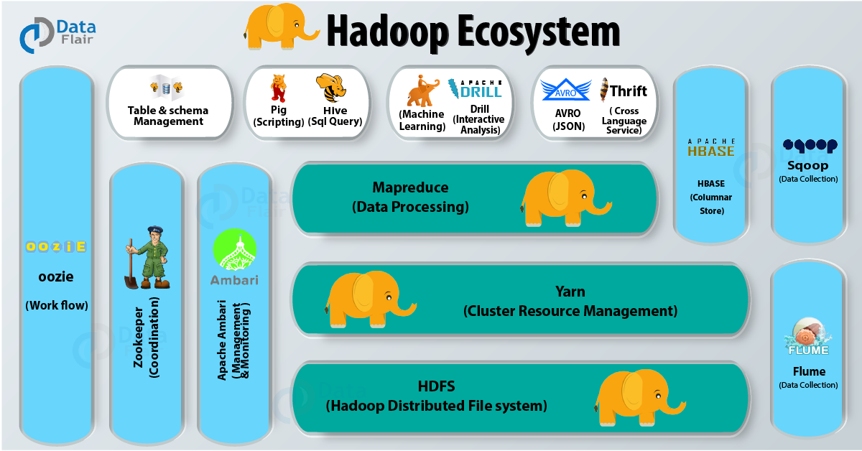
Hadoob ecosystem
Notes:
Image source:https://data-flair.training/blogs/hadoop-ecosystem/
Hadoop maps perfectly to the Big Data architecture: it ingests data (Sqoop/Flume), stores it at scale (HDFS/HBase), processes it in parallel (MapReduce/Hive), manages resources (YARN), and delivers insights for analytics.

Slide 6



Hadoob ecosystem components
Hadoob ecosystem core components:
• Hadoop Distributed File System (HDFS): the distributed storage layer of Hadoop.
• Map-Reduce: the parallel data processing layer of Hadoop.
• YARN: the resource management and job scheduling layer of Hadoop.
Notes:
Developed by Apache Software Foundation
Created by Doug Cutting
Enables scalable and fault-tolerant Big Data analytics
Available through industry distributions:
Cloudera
Hortonworks
IBM BigInsights
MapR
YARN Allows multiple processing frameworks (MapReduce, Spark, etc.) to share the same cluster

Slide 7


Hadoob ecosystem components
Data storage and query tools
HBase
Column-oriented NoSQL database built on top of HDFS.
Supports random, real-time read/write access to large sparse datasets.
Hive
Data warehousing tool that provides SQL-like querying (HiveQL) on data stored in HDFS.
Notes:
Hive : an open source data warehouse system for querying and analyzing large datasets stored in Hadoop files. Hive do three main functions: data summarization, query, and analysis.
Hive use language called HiveQL (HQL), which is similar to SQL. HiveQL automatically translates SQL-like queries into MapReduce jobs which will execute on Hadoop.
HBase
a distributed database that was designed to store structured data in tables that could have billions of row and millions of columns. HBase is scalable, distributed, and NoSQL database that is built on top of HDFS. HBase, provide real-time access to read or write data in HDFS.

Slide 8



Hadoob ecosystem components
Data Processing & Ingestion Tools
Pig
High-level scripting language for data processing on Hadoop.
Flume
Distributed service for real-time log and event data ingestion into HDFS or HBase.
Commonly used for collecting application and server logs.
Sqoop
Tool for bulk data transfer between Hadoop and relational databases (RDBMS).
Supports importing/exporting data efficiently using parallelism.
Notes:
PIG: a high-level language platform for analyzing and querying huge dataset that are stored in HDFS. Pig as a component of Hadoop Ecosystem uses PigLatin language.
loads the data, applies the required filters and dumps the data in the required format. For Programs execution, pig requires Java runtime environment.
Apache Sqoop
imports data from external sources into related Hadoop ecosystem components like HDFS, Hbase or Hive. It also exports data from Hadoop to other external sources. Sqoop works with relational databases such as teradata, Netezza, oracle, MySQL.
Apache Flume
efficiently collects, aggregate and moves a large amount of data from its origin and sending it back to HDFS. It is fault tolerant and reliable mechanism.
Using Flume, we can get the data from multiple servers immediately into hadoop.

Slide 9



Hadoob ecosystem components
Workflow, Coordination & Analytics
Oozie
Workflow scheduler for Hadoop jobs. Allows chaining multiple jobs (MapReduce, Hive, Pig, Spark) into a single workflow.
ZooKeeper
Centralized coordination service for distributed systems.
Used for configuration management, and synchronization.
Mahout
Scalable machine learning library built on Hadoop.
Supports clustering, classification, and recommendation algorithms.
Notes:
Apache Mahout
open source framework for creating scalable machine learning algorithm and data mining library. Once data is stored in Hadoop HDFS, mahout provides the data science tools to automatically find meaningful patterns in those big data sets.

Slide 10
Big Data Architecture Layers vs. Hadoop Ecosystem
Architecture Layer | Purpose | Hadoop Tools
Layer 1: Data Sources | Identify internal & external data sources (structured, semi-structured, unstructured) | Databases, Logs, Web apps, Sensors (external to Hadoop)
Layer 2: Data Ingestion & Acquisition | Collect data in batch or real time, ELT, validation | Sqoop (RDBMS → Hadoop), Flume (logs & streams)
Layer 3: Data Storage | Scalable, fault-tolerant storage and schema management | HDFS (distributed file system), HBase (NoSQL column store)
Layer 4: Data Processing | Batch, interactive, and analytical processing | MapReduce, Hive (SQL), Pig (scripting),
Layer 5: Data Consumption | Analytics, reporting, visualization, data export | Hive(BI/SQL ana;ytics), HBase (applications)

Slide 11
Hadoop Distributed File System (HDFS)
HDFS is a file system designed for storing very large files with streaming data access patterns, running on clusters of commodity hardware
Very large files → HDFS is designed to store and process extremely large files ranging from hundreds of megabytes to petabytes across distributed clusters.
Streaming data access → HDFS is optimized for write-once, read-many access patterns. It is optimized for high-throughput batch processing rather than low-latency access, prioritizing reading entire datasets quickly over fast retrieval of individual records.
Commodity hardware → Hadoop runs on low-cost commodity hardware and remains fault-tolerant by automatically handling frequent node failures without disrupting users.
Notes:
Very large files
“Very large” in this context means files that are hundreds of megabytes, gigabytes,
or terabytes in size. There are Hadoop clusters running today that store petabytes
of data.2
Streaming data access
HDFS is built around the idea that the most efficient data processing pattern is a
write-once, read-many-times pattern. A dataset is typically generated or copied
from source, and then various analyses are performed on that dataset over time.
Each analysis will involve a large proportion, if not all, of the dataset, so the time
to read the whole dataset is more important than the latency in reading the first
record.
Commodity hardware
Hadoop doesn’t require expensive, highly reliable hardware. It’s designed to run on
clusters of commodity hardware (commonly available hardware that can be obtained
from multiple vendors)3 for which the chance of node failure across the
cluster is high, at least for large clusters. HDFS is designed to carry on working
without a noticeable interruption to the user in the face of such failure.

Slide 12
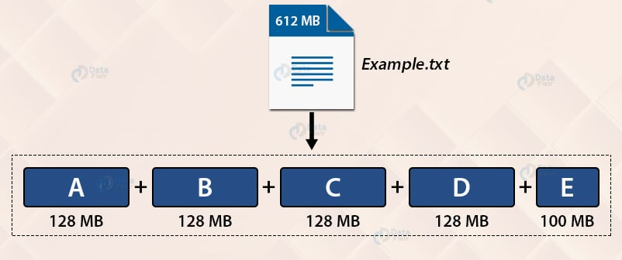
Hdfs storage concepts
HDFS Blocks
HDFS stores files as large blocks (128 MB by default – configurable) to reduce disk seek overhead and maximize data transfer throughput.
Large blocks enable efficient batch processing but must be balanced to ensure enough parallel tasks in MapReduce or Spark jobs.
Block Size Trade-off (Balancing):
Too large blocks: Fewer blocks, Fewer tasks are created, so some cluster nodes sit idle and Job runs slower than it could
Too small blocks: too many tasks, High scheduling, and high task startup overhead
Notes:
In HDFS the main target is storage without understanding data meaning
Storage (HDFS) only knows blocks of bytes. Sharding is implemented by higher-level systems that decide which records go where, then store the result on HDFS.
So sharding is a data layout decision, not a storage mechanism.
HDFS stays simple and fast ✅ Multiple engines can shard differently ✅ Sharding strategies can evolve
Sharding is implemented by data processing systems that control how records are grouped into files and directories, while HDFS only provides block-based, fault-tolerant storage without understanding data semantics.
HDFS Blocks vs Data Sharding
HDFS Blocks
A storage-level concept used by HDFS to split files into fixed-size chunks (e.g., 128 MB) for distributed storage and fault tolerance.
Blocks are automatically managed by HDFS and are transparent to applications.
Purpose: efficient storage, replication, and high-throughput data access.
Data Sharding
An application-level or database concept where data is deliberately partitioned (by key, range, or hash) across nodes.
Shards are logically meaningful and directly impact query routing and performance.
Purpose: scalability, load balancing, and parallel query execution.
Key Difference
Blocks are physical storage units, while shards are logical data partitions defined by application or schema design.
How They Relate
A single shard may span multiple HDFS blocks, and each block may be replicated across nodes.
Systems like HBase or Hive use HDFS blocks underneath while implementing sharding at a higher level.
If you want,

Slide 13
Dataset: 1 TB Cluster: 100 nodes
Block Size | # Blocks | # Parallel Tasks | Result
128 MB | ~8,000 | ~8,000 | Good parallelism
512 MB | ~2,000 | ~2,000 | OK parallelism
1 GB | ~1,000 | ~1,000 | Some nodes idle
10 GB | 100 | 100 | Poor parallelism

Slide 14
Hdfs storage concepts
Block abstraction is the architectural foundation that enables HDFS to achieve scalability, manageability, and fault tolerance.
Benefits of Block Abstraction in HDFS
Supports massive files: Files are split into independent blocks that can be stored across many disks and machines, allowing file sizes to exceed single-disk capacity.
Simplifies storage management: Uniform block sizes simplify data placement, load balancing, replication, and recovery. The NameNode manages metadata separately from actual data storage.
Enables fault tolerance: Blocks are replicated across multiple Nodes, so failures are handled without losing data.
Notes:
Block abstraction means that HDFS treats data as fixed-size blocks instead of whole files.
In simple terms
A file is not stored as one piece.
It is broken into equal-sized blocks (e.g., 128 MB).
Each block is handled independently by the system.
What HDFS “sees”
Blocks → stored, replicated, moved, and recovered
Files → just a logical view created by stitching blocks together
Why it’s called an abstraction
Users work with files
HDFS internally works with blocks
The complexity of splitting, placing, and replicating data is hidden from users

Slide 15
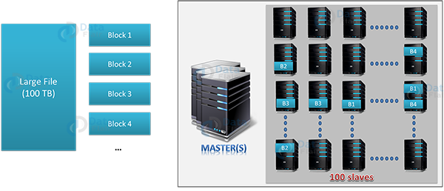
Notes:
How HDFS Stores Data (As Shown in the Figure)
Large file input
A very large file (e.g., 100 TB) is uploaded to HDFS as a single logical file from the user’s perspective.
File splitting into blocks
HDFS automatically splits the file into fixed-size blocks (e.g., Block 1, Block 2, Block 3, Block 4, …).
Each block is typically 128 MB (configurable).
Metadata handled by the Master (NameNode)
The Master (NameNode) does not store data itself.
It stores metadata: file names, block IDs, and which DataNodes hold each block.
Blocks distributed across DataNodes (slaves)
Each block is stored on different DataNodes across the cluster (e.g., 100 slave nodes).
Blocks are not stored sequentially on one machine.
Replication for fault tolerance
Every block is replicated (commonly 3 copies).
Replicas are placed on different DataNodes to survive disk or node failures.
Parallel storage and access
Different blocks of the same file are stored on different nodes, enabling parallel reads and writes.
Multiple compute tasks can process different blocks at the same time.
Failure handling
If a DataNode fails, HDFS automatically reads the block from another replica.
Missing replicas are recreated to maintain the replication factor.
Transparent to the user
Users see one large file, not blocks.
Block management, placement, and recovery are fully handled by HDFS.
HDFS breaks large files into blocks, spreads and replicates them across many machines, and uses a master node to track where each block lives—enabling scalable, fault-tolerant storage.

Slide 16
Hdfs architecture
HDFS Nodes
HDFS follows a master–worker architecture with a NameNode (master) and multiple DataNodes (workers).
The NameNode manages the file system namespace and metadata, including the directory structure, file permissions, and file-to-block mapping.
Metadata is stored persistently as the namespace image (Fsimage) and the edit log, while block locations are reconstructed from DataNodes at startup.
Clients interact with the file system through an interface by communicating with the NameNode for metadata and DataNodes for actual data
Notes:
the file system namespace, that is information about blocks of files like block locations, permissions, etc.
The NameNode stores information about blocks locations, permissions, etc. on the local disk in the form of two files:
Fsimage: Fsimage stands for File System image. It contains the complete namespace of the Hadoop file system since the NameNode creation.
Edit log: It contains all the recent changes performed to the file system namespace to the most recent Fsimage.
The NameNode uses a transaction log called the EditLog to persistently record every change that occurs to file system metadata. For example, creating a new file in HDFS causes the NameNode to insert a record into the EditLog indicating this. Similarly, changing the replication factor of a file causes a new record to be inserted into the EditLog. The NameNode uses a file in its local host OS file system to store the EditLog. The entire file system namespace, including the mapping of blocks to files and file system properties, is stored in a file called the FsImage. The FsImage is stored as a file in the NameNode’s local file system too.
When the NameNode starts up, it reads the FsImage and EditLog from disk, applies all the transactions from the EditLog to the in-memory representation of the FsImage, and flushes out this new version into a new FsImage on disk. It can then truncate the old EditLog because its transactions have been applied to the persistent FsImage. This process is called a checkpoint.
Safe Mode
A brief mention of Safe Mode. This is the read-only state HDFS enters during startup where it waits for a certain percentage of blocks to be reported by DataNodes before allowing writes.

Slide 17
Hdfs architecture
HDFS Nodes
DataNodes are inexpensive commodity hardware. They store and retrieve data blocks, serve read/write requests, and periodically report block information to the NameNode.
The NameNode is critical to file system operation; without it, files cannot be reconstructed from blocks.
To improve reliability, NameNode metadata can be backed up to multiple storage locations, and a Secondary NameNode can create checkpoints by merging the fsimage and edit log.
The NameNode manages metadata and coordination, while DataNodes store the actual data blocks and perform all data I/O.

Slide 18
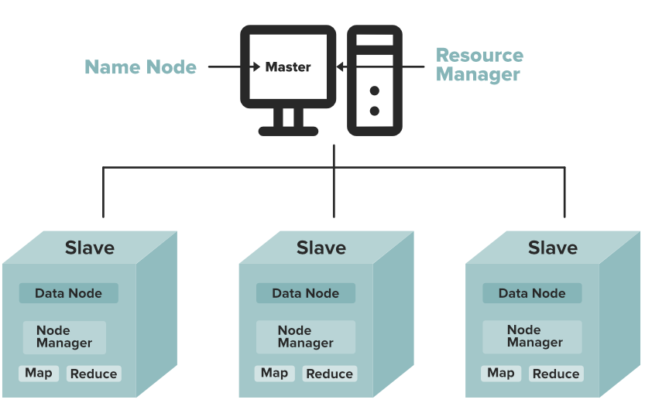
Tasks of HDFS NameNode (Master)
Manages the filesystem namespace and file metadata (directories, permissions, block mapping).
Tracks which DataNodes store each data block.
Coordinates client access and monitors DataNode health.
Tasks of HDFS DataNode (Slave)
Stores and serves actual data blocks on local disks.
Handles read/write requests from clients.
Reports block status and health information to the NameNode.
Notes:
Functions of HDFS NameNode
It executes the file system namespace operations like opening, renaming, and closing files and directories.
NameNode manages and maintains the DataNodes.
It determines the mapping of blocks of a file to DataNodes.
NameNode records each change made to the file system namespace.
It keeps the locations of each block of a file.
NameNode takes care of the replication factor of all the blocks.
NameNode receives heartbeat and block reports from all DataNodes that ensure DataNode is alive.
If the DataNode fails, the NameNode chooses new DataNodes for new replicas.
Functions of DataNode
DataNode is responsible for serving the client read/write requests.
Based on the instruction from the NameNode, DataNodes performs block creation, replication, and deletion.
DataNodes send a heartbeat to NameNode to report the health of HDFS.
DataNodes also sends block reports to NameNode to report the list of blocks it contains.

Slide 19
Heartbeats and Block Reports
How does NameNode know a node failed?
Each DataNode in the Hadoop Distributed File System (HDFS) cluster is responsible for sending regular heartbeat messages (typically every 3 seconds) to the NameNode. These heartbeats serve as an "I am alive" signal.
The NameNode maintains a record of the last time it received a heartbeat from each DataNode. If the NameNode does not receive a heartbeat within a predefined timeout period, it assumes the DataNode has failed or is unresponsive.
Once a node is marked as dead, the NameNode initiates a process to replicate the data blocks that were stored on the failed node to other active DataNodes in the cluster to maintain the configured replication factor and ensure data reliability .

Slide 20
Heartbeats and Block Reports
DataNodes periodically send "block reports" to the NameNode that contain A complete list of all blocks currently stored on a this DataNode.. This helps the NameNode maintain an accurate and up-to-date map of data block locations across the cluster
NameNode uses block reports to:
Track block locations
Detect under-replication
Failed blocks are automatically re-replicated
Notes:
Without block reports, the NameNode would not know:
Where blocks physically exist
Which replicas are alive
Whether a block copy was lost
Block reports ensure:
The metadata reflects reality.
Heartbeat Block Report
Sent frequently (few seconds) Sent periodically (longer interval)
"I am alive“ "Here are all my blocks“
Small message Large metadata message

Slide 21
Hdfs architecture
HDFS Nodes
Secondary NameNode is a helper node in HDFS that supports the primary NameNode, but it is NOT a backup or replacement.
Why It Exists ???
The NameNode stores file system metadata in two files:
FsImage → snapshot of the file system
Edit Log → all recent changes
Since the NameNode runs continuously, the edit log keeps growing which causes:
Slow NameNode restart
High memory and processing overhead during recovery
Notes:
Secondary NameNode in HDFS
Role: Helper daemon that performs checkpointing
Main Task: Merge FsImage + Edit Logs periodically
Benefit: Prevents edit logs from growing too large
Result: Faster NameNode restart and improved stability
Failure Handling: Provides latest checkpoint for manual recovery
Key Point: ❗ Not a standby or replacement NameNode
The Secondary NameNode improves NameNode reliability and restart performance by periodically checkpointing filesystem metadata.
In a non-HA deployment, checkpointing is done on the SecondaryNameNode rather than the standby NameNode.
Standby NameNode replaces the Secondary NameNode in Hadoop HA clusters by providing both checkpointing and automatic failover.
Secondary NameNode → restart optimization
Standby NameNode → availability + recovery + checkpointing

Slide 22
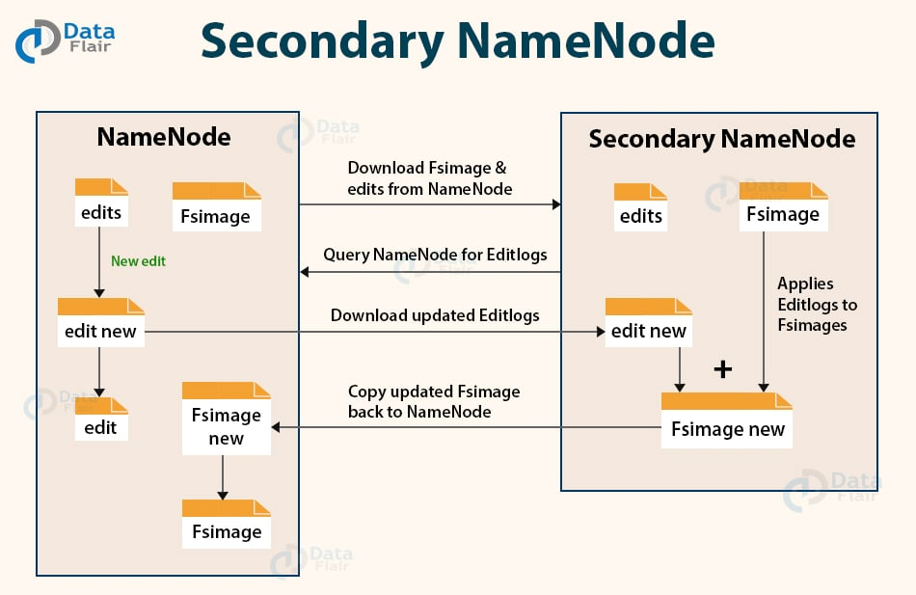
Hdfs Architecture
HDFS Nodes
What the Secondary NameNode Does:
Periodically copies FsImage and Edit Logs from the NameNode
Merges the Edit Logs into the FsImage (checkpointing)
Creates a new updated FsImage
Sends the updated FsImage back to the NameNode
This keeps the edit log small and manageable
Secondary NameNode does not take over automatically if NameNode fails but It helps recovery by providing a recent checkpoint
Notes:
Image source https://data-flair.training/blogs/wp-content/uploads/sites/2/2017/06/HDFS-secondary-namenode.jpg
Secondary NameNode Checkpointing Flow (Explained)
Step-by-step flow:
NameNode runs continuously
FsImage = old snapshot
EditLogs = growing changes
Secondary NameNode starts checkpoint
Downloads FsImage + EditLogs from NameNode
Merge process
Applies all EditLogs to FsImage
Creates a new updated FsImage
Checkpoint upload
Sends merged FsImage back to NameNode
Cleanup
NameNode replaces old FsImage
EditLogs are reset (small again)
👉 Result: Fast restart + stable metadata management

Slide 23
Example
An organization operates a large HDFS-based data platform used to store: Application logs, Images, and Analytical datasets
In HDFS: The default block size is 128 MB and Each block requires 150 bytes of metadata stored in the NameNode memory
The following is the dataset description
Later, the system ingests:3 million small files, each exactly 1 MB in size
File Type | Number of Files | File Size
Log files | 2 million | 256 MB
Image files | 1 million | 300 MB
Data files | 500,000 | 512 MB

Slide 24
Example
Calculate the number of HDFS blocks required per file for each file type
Calculate the total number of HDFS blocks:
Before adding small files
After adding small files
Compute the total NameNode memory required for metadata in both cases
Explain how adding many small files impacts NameNode scalability
Notes:
In HDFS:
Metadata is stored in the NameNode’s RAM. Every file and every block consumes memory.
HDFS is optimized for:
Few very large files
Not millions of small files
--------------------------------------------------------
LARGE FILE STORAGE Few files Few blocks Low metadata High efficiency Fast restart SMALL FILE STORAGE Millions of files Millions of blocks High metadata usage Wasted block space Slow restart NameNode bottleneck

Slide 25
Hdfs balancer
Why We Need the Balancer?
HDFS clusters grow over time. When you add new DataNodes:
Existing nodes already store large amounts of data
New nodes start completely empty
HDFS does NOT automatically move old data to new nodes
This creates data skew:
Some nodes are 90% full
Others are 10% full
Jobs reading data become slower because:
Busy nodes serve most read requests
Network and disks on those nodes become overloaded

Slide 26
Hdfs balancer
The HDFS Balancer is an administrative background tool that:
Monitors disk usage across all DataNodes
Identifies imbalances:
Over-utilized nodes (too full)
Under-utilized nodes (too empty)
Gradually moves blocks from full nodes to empty ones
Important details:
Balancing happens without downtime
Data integrity and replication rules are preserved
Movement is throttled to avoid network congestion
Notes:
1. Monitoring Disk Usage
The balancer checks each DataNode’s disk utilization.
It collects metrics like used space vs total space.
Example:
Node 1: 90% full
Node 2: 60% full
Node 3: 30% full
2. Identifying Imbalances
Over-utilized nodes: Nodes storing significantly more data than the cluster average.
Under-utilized nodes: Nodes storing less data than the cluster average.
The balancer calculates a threshold (default 10%). Nodes beyond this are candidates for block movement.
3. Gradual Block Movement
The balancer moves HDFS blocks from full nodes to emptier nodes.
Example: Node 1 may transfer some blocks to Node 3 until both reach similar usage.
It respects HDFS rules, including:
Replication factor: No block loses its replicas.
Data integrity: Blocks are never partially moved; they are copied first, then the original is deleted once confirmed.
4. Important Features
No downtime
The cluster continues serving read/write requests while balancing occurs.
Users don’t notice any interruption.
Data integrity is preserved
Blocks are copied safely; replication rules are strictly enforced.
HDFS ensures that even if a node fails during balancing, data is safe.
Throttled movement
To avoid saturating the network, the balancer moves blocks at a controlled speed.
Administrators can adjust the bandwidth limit, e.g., only use 50% of network capacity.

Slide 27
HDFS balancer example
A Hadoop cluster consists of 3 DataNodes, each with a capacity of 100 GB. The current used space on each node is as follows:
The cluster administrator wants to balance the HDFS data using the HDFS Balancer. The balancer threshold is set to 10%.
DataNode | Capacity (GB) | Used (GB)
Node1 | 100 | 90
Node2 | 100 | 60
Node3 | 100 | 50

Slide 28
HDFS balancer example
1- Compute the current usage percentage of each DataNode.
2- Compute the cluster average usage.
3- Determine the deviation of each node from the cluster average.
4- Identify which nodes are unbalanced (over-utilized or under-utilized) based on the threshold.
5- Explain which nodes will send/receive blocks during balancing to achieve a balanced state.

Slide 29
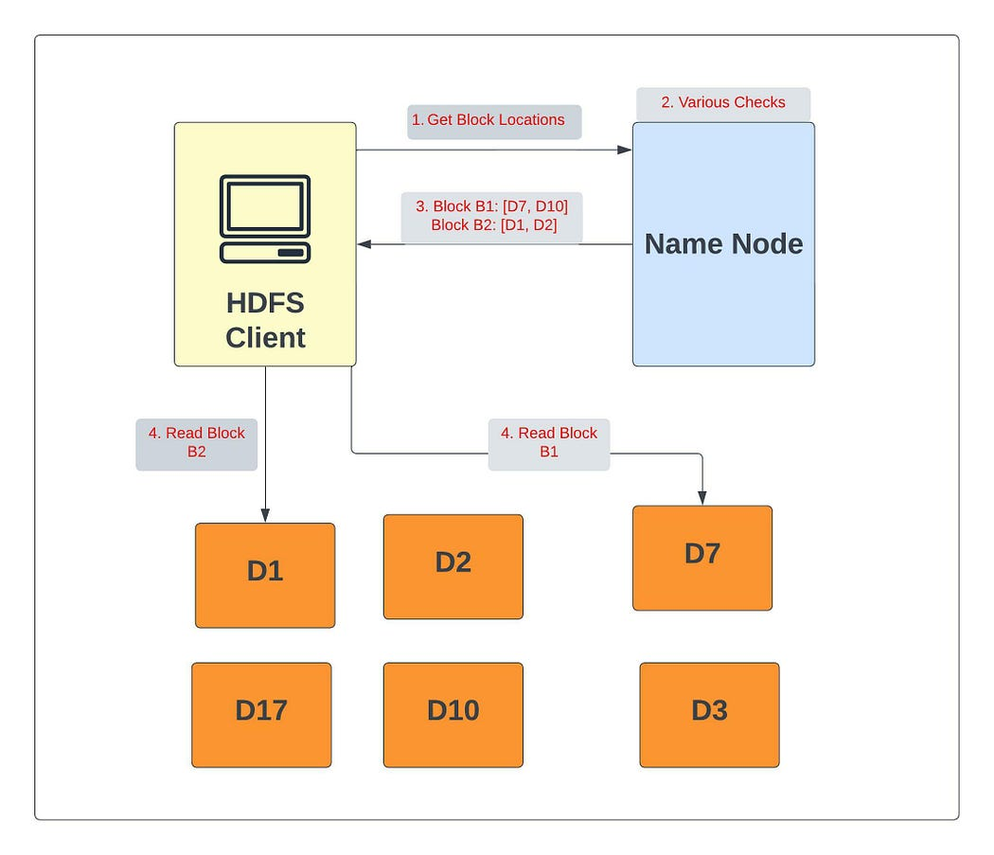
Hdfs data flow
Read Operation
Client contacts the NameNode to get file and block information.
NameNode provides a list of DataNodes for each block (B1, B2, …).
Client connects directly to DataNodes (not through the NameNode).
Blocks are read in parallel from multiple DataNodes for higher throughput.
If a DataNode fails or a block is corrupted, the client automatically reads from the next DataNode replica in the list.
Notes:
Image source: https://medium.com/@mukulranjan/understanding-hdfs-architecture-a58ecb1bf808
Client requests metadata
Client contacts the NameNode to get file and block information.
NameNode returns block locations
NameNode provides a list of DataNodes for each block (B1, B2, …).
Client reads data directly
Client connects directly to DataNodes (not through the NameNode).
Parallel data reading
Blocks are read in parallel from multiple DataNodes for higher throughput.
Failure handling
If a DataNode fails or a block is corrupted, the client automatically reads from the next DataNode replica in the list.
Data flows to client
Data flows DataNode → Client, ensuring efficiency and scalability.
When a client or application receives all the blocks of the file, it combines these blocks into the form of an original file.
4. Short-Circuit Local Reads
In the "Read Operation" section, you explain that clients read from DataNodes.
Improvement: If a client (like a Spark task) is running on the same machine as the DataNode holding the data, it can bypass the network stack and read directly from the local disk. This is called Short-Circuit Local Read and is a major performance boost.

Slide 30
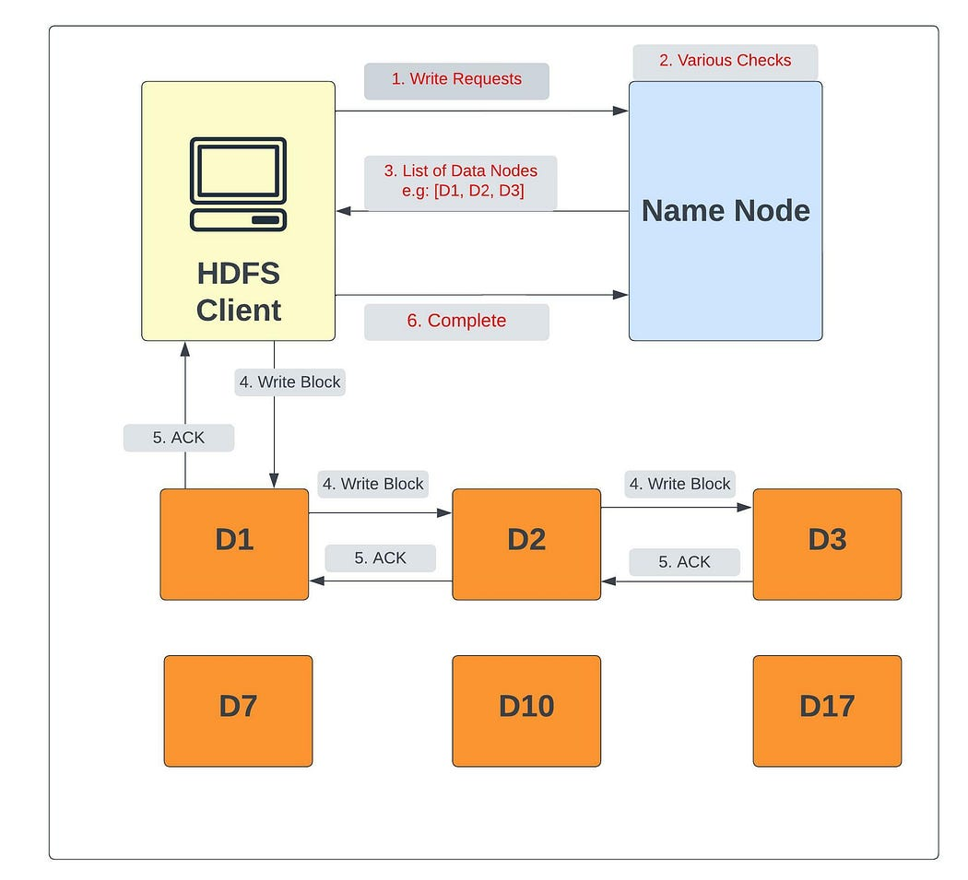
Hdfs data flow
Write Operation
Client contacts the NameNode to create a new file and request metadata.
Verifies file existence, permissions, and client authorization.
NameNode returns Block ID, and a List of DataNodes for replicas
Client writes data directly to the first DataNode., and Data is replicated in a pipeline to other DataNodes.
If a DataNode fails, data is written to remaining nodes. NameNode detects under-replication and selects a new DataNode.
After required replicas are created, success acknowledgment is sent to the client.
Notes:
Image source: https://medium.com/@mukulranjan/understanding-hdfs-architecture-a58ecb1bf808
Client requests write access
Client contacts the NameNode to create a new file and request metadata.
NameNode performs checks
Verifies file existence, permissions, and client authorization.
Block & DataNode assignment
NameNode returns:
Block IDs
List of DataNodes for replicas (e.g., D1, D2, D3 for RF=3)
Client writes data
Client writes data directly to the first DataNode.
Data is replicated in a pipeline to other DataNodes.
Replication handling
Each block is stored on all assigned DataNodes.
Steps repeat until the entire file is written.
Failure recovery
If a DataNode fails, data is written to remaining nodes.
NameNode detects under-replication and selects a new DataNode.
Acknowledgement
After required replicas are created, success acknowledgment is sent to the client.
Acknowledgments (ACKs) flow backward through the pipeline
Write is successful only after all ACKs are received
NameNode manages metadata, while data flows directly from client to DataNodes for efficient and fault-tolerant writes.

Slide 31
Hdfs data flow
A client writes a block to HDFS with a replication factor of 3. If the acknowledgment from the second DataNode is delayed by 2 seconds, what happens to the client write operation?
The client waits
The write is not considered complete
HDFS commits the write only after all ACKs are received

Slide 32
Hdfs Reliability & Scalability
HDFS Fault Tolerance and Replication Management
HDFS achieves fault tolerance through data replication.
Each file is split into blocks, and each block is stored on multiple DataNodes.
Replication factor defines “how many copies of each block are stored”.
Example: Replication factor = 3 → 3 copies of each block on different DataNodes.
If one DataNode fails, data is still available from other replicas.
Storage trade-off:
128 MB block × 3 replicas = 384 MB total storage
Replication ensures high availability and reliability of data.

Slide 33
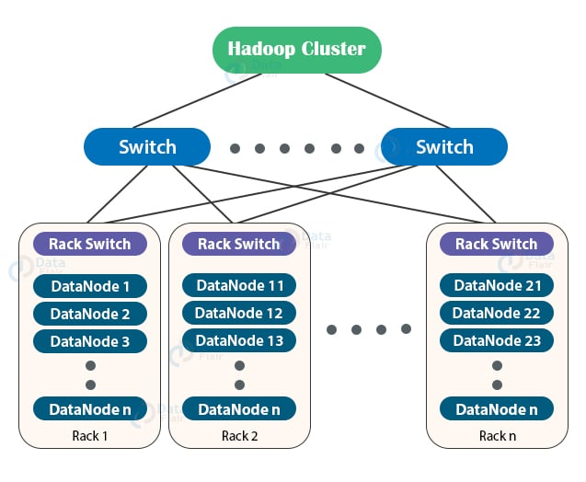
Hdfs Reliability & Scalability
HDFS Fault Tolerance and Replication Management
A rack is a group of DataNodes (40 – 50) connected to the same network switch.
If a rack fails, all nodes in that rack become unavailable.
Notes:
Image source: https://data-flair.training/blogs/wp-content/uploads/sites/2/2020/02/hadoop-cluster.jpg
Nodes in the same rack typically have faster network connectivity with each other than with nodes in other racks.
Large clusters often have hundreds or thousands of nodes, which cannot fit in a single rack.
Rack Awareness is a placement policy used by HDFS to:
Intelligently distribute block replicas across different racks.
The NameNode knows the rack topology and uses it when deciding where to store replicas.
Replica Placement Strategy (Replication Factor = 3)
In modern rack-aware HDFS (Apache Hadoop), the standard policy is:
1️⃣ First replica → local DataNode (local rack) 2️⃣ Second replica → another DataNode in the same rack 3️⃣ Third replica → DataNode in a different rack
Fault Tolerance Analysis
Case 1: Single DataNode Failure
Only one replica lost → Still 2 remaining → Safe
Case 2: Entire Rack Failure
Two replicas lost (from same rack) One replica survives (in different rack) → Data preserved
This protects against:
Switch failure
Power failure in a rack
Maintenance downtime
🚀 Benefits of Rack-Aware Replication
✅ 1. Improved Fault Tolerance
Protects against node-level AND rack-level failures
Enables self-healing via re-replication
✅ 2. Reduced Network Latency
Reads prefer:
Local replica
Same rack replica
Cross-rack only if needed
✅ 3. Better Write Performance
Write pipeline example:
Client writes → DN1 → DN2 → DN3
If DN1 and DN2 are in same rack:
First replication is fast (intra-rack)
Only one cross-rack transfer needed
This reduces:
Cross-switch bandwidth usage
Congesti

Slide 34
Hdfs Reliability & Scalability
HDFS Fault Tolerance and Replication Management
A rack is a group of DataNodes (40 – 50) connected to the same network switch.
If a rack fails, all nodes in that rack become unavailable.
Rack Awareness helps HDFS place replicas intelligently across racks by avoiding storing all replicas on the same rack.
For replication factor = 3:
First replica → local rack, Second replica → another datanode in the same local rack and Third replica → different rack
Benefits:
Improved fault tolerance (node-level and rack-level failures)
Reduced network latency
Better read/write performance
Notes:
Nodes in the same rack typically have faster network connectivity with each other than with nodes in other racks.
Large clusters often have hundreds or thousands of nodes, which cannot fit in a single rack.
Rack Awareness is a placement policy used by HDFS to:
Intelligently distribute block replicas across different racks.
The NameNode knows the rack topology and uses it when deciding where to store replicas.
Replica Placement Strategy (Replication Factor = 3)
In modern rack-aware HDFS (Apache Hadoop), the standard policy is:
1️⃣ First replica → local DataNode (local rack) 2️⃣ Second replica → another DataNode in the same rack 3️⃣ Third replica → DataNode in a different rack
Fault Tolerance Analysis
Case 1: Single DataNode Failure
Only one replica lost → Still 2 remaining → Safe
Case 2: Entire Rack Failure
Two replicas lost (from same rack) One replica survives (in different rack) → Data preserved
This protects against:
Switch failure
Power failure in a rack
Maintenance downtime
🚀 Benefits of Rack-Aware Replication
✅ 1. Improved Fault Tolerance
Protects against node-level AND rack-level failures
Enables self-healing via re-replication
✅ 2. Reduced Network Latency
Reads prefer:
Local replica
Same rack replica
Cross-rack only if needed
✅ 3. Better Write Performance
Write pipeline example:
Client writes → DN1 → DN2 → DN3
If DN1 and DN2 are in same rack:
First replication is fast (intra-rack)
Only one cross-rack transfer needed
This reduces:
Cross-switch bandwidth usage
Congesti

Slide 35
Notes:
Image source: https://data-flair.training/blogs/wp-content/uploads/sites/2/2017/01/HDFS-rack-awareness.gif

Slide 36
Example
An organization stores large analytical datasets in an HDFS cluster configured with rack awareness.
The cluster has:
3 racks (Rack A, Rack B, Rack C)
5 DataNodes per rack (15 DataNodes total)
HDFS block size = 128 MB
Replication factor = 3
A dataset of 2 TB is uploaded to HDFS.
Requirements
Calculate the number of HDFS blocks created for the dataset
Calculate the total physical storage required due to replication
Determine where replicas of each block are placed according to rack awareness

Slide 37
Hdfs Reliability & Scalability
Erasure Coding (EC) (introduced in Hadoob3)
Erasure Coding (EC) is an HDFS storage option that provides fault tolerance like replication but with much less storage overhead. Instead of storing many full replicas, EC stores data blocks + parity blocks computed via encoding, similar to RAID techniques.
Why Use Erasure Coding?
Lower Storage Overhead: Much less than 3× replication Example: 6 data blocks + 3 parity blocks → 9 total blocks (≈50% overhead), vs replication’s 18 blocks.
Same Fault Tolerance: Can recover missing data using parity
Good for Warm/Cold Data: Less frequently accessed datasets benefit most
Notes:
Introduced in hadoob 3

Slide 38
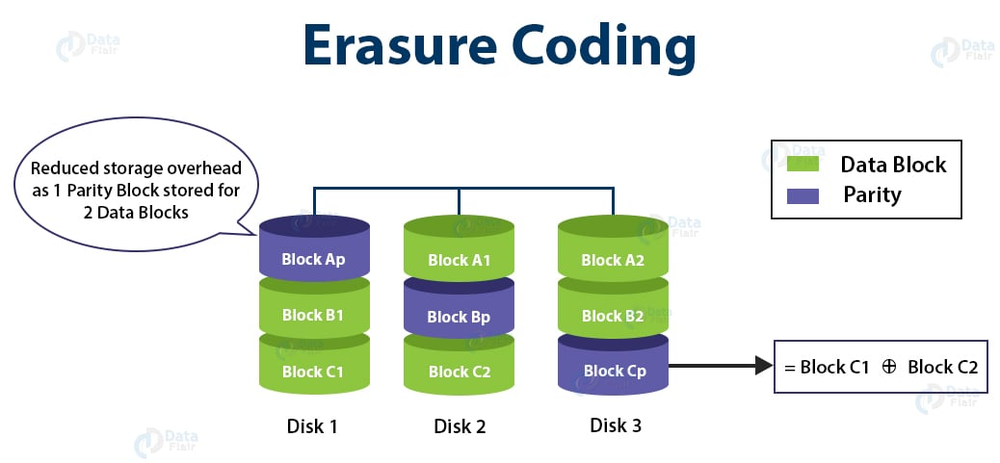

Slide 39
Hdfs Reliability & Scalability
Erasure Coding (EC)
How It Works
Stripe: Input file split into data blocks or stripes
Encode: Parity blocks generated based on EC policy
Distribute: Blocks spread across DataNodes and racks for fault tolerance
Reconstruct: If blocks fail, decode using surviving data + parity
An Erasure Coding (EC) policy defines how data and parity blocks are organized and how many failures HDFS can tolerate.
It is written as: RS-k-m (k = data blocks, m = parity blocks)
Notes:
Assignment: https://www.cloudera.com/blog/technical/introduction-to-hdfs-erasure-coding-in-apache-hadoop.html
Most Common HDFS EC Policy
🔹 RS-6-3 (Default Policy)
Stripe Layout +----+----+----+----+----+----+----+----+----+ | D1 | D2 | D3 | D4 | D5 | D6 | P1 | P2 | P3 | +----+----+----+----+----+----+----+----+----+ Data Blocks (6) Parity Blocks (3)
Total blocks per stripe = 9
Can tolerate up to 3 DataNode failures
Storage overhead = 50%
Much lower than replication (200%)
How Fault Tolerance Works
Any k blocks are enough to reconstruct the data
If up to m blocks fail, HDFS:
Reads remaining blocks
Uses parity to rebuild missing blocks
✔ Same durability as replication, with far less storage
When to Use Which Policy
RS-6-3 → Large, cold/warm datasets (logs, archives)
Replication → Hot data, low latency access
Smaller policies → Smaller clusters with fewer nodes
Starting with Hadoop 3:
Hot data → uses replication (fast access)
Cold data / archival → uses EC (save storage)
So EC does not completely eliminate replication. It complements it.

Slide 40
example
An organization stores 900 TB of log data in HDFS.
They are considering two storage strategies:
Option A: Replication
Replication Factor = 3
Option B: Erasure Coding
Policy = RS-6-3
Calculate the total physical storage required using Replication (RF=3)
Calculate the total physical storage required using Erasure Coding (RS-6-3)
How much storage is saved by using Erasure Coding instead of Replication?
Notes:
Replication (RF = 3)
Each block is stored 3 times
Total Storage=900×3=2700 TB
Erasure Coding (RS-6-3)
Total blocks per stripe = 6 + 3 = 9
Storage overhead factor = 9 / 6 = 1.5
Total Storage=900×1.5=1350 TB
Storage Savings
Savings=2700−1350=1350 TB ✔ 50% reduction in storage
Design Decision
✅ Erasure Coding is better for cold log data because:
Logs are rarely read
Storage efficiency is critical
Slight latency increase is acceptable

Slide 41
Hdfs Reliability & Scalability
With Hadoop 1.x, the NameNode was a single point of failure, if it failed, the cluster went down.
Hadoop 2.x introduced two major improvements to solve this:
HDFS Federation
High Availability (HA)
Both enhance cluster reliability but address different problems.

Slide 42
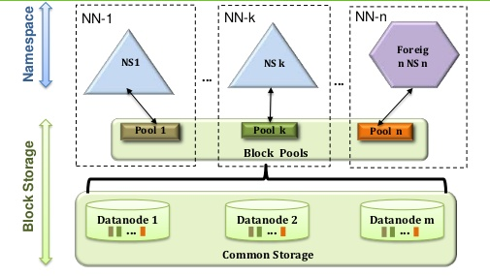
Hdfs Reliability & Scalability
HDFS Federation allows multiple independent NameNodes to exist in the same cluster.
Each NameNode manages its own namespace and associated block pool.
Namespaces are independent: one NameNode’s failure doesn’t affect others.
DataNodes store blocks for all NameNodes and register with each one.
Federation improves namespace scalability, isolation, and performance by distributing metadata load.
Notes:
Block Pool- Block pool is nothing but the set of blocks that belong to a single namespace. There are set of blocks in the HDFS federation and each block is managed independently.
Namespace Volume- Namespace along with its block pool is namespace volume. You can find many namespace volumes in HDFS federation. Again, all these namespace volumes work independently.
The problem it solves
The NameNode keeps all metadata in memory (files, directories, blocks).
As clusters grow (millions of files), NameNode memory becomes the scaling bottleneck.
Even if you add more DataNodes, one NameNode limits the entire system.
What HDFS Federation does
HDFS Federation allows multiple NameNodes in the same cluster.
Each NameNode manages only a portion of the filesystem namespace.
Example:
NameNode 1 → /user
NameNode 2 → /share
This splits metadata responsibility and removes the single-NameNode scalability limit.
HDFS Federation scales metadata management by splitting the filesystem namespace across multiple independent NameNodes while sharing the same DataNodes.
Isolation- Earlier with Hadoop 1 there was no isolation involved with multi-user scenario. This has been overcome by using the HDFS federation where different applications can be isolated to a different namespace by using multiple namenode.

Slide 43
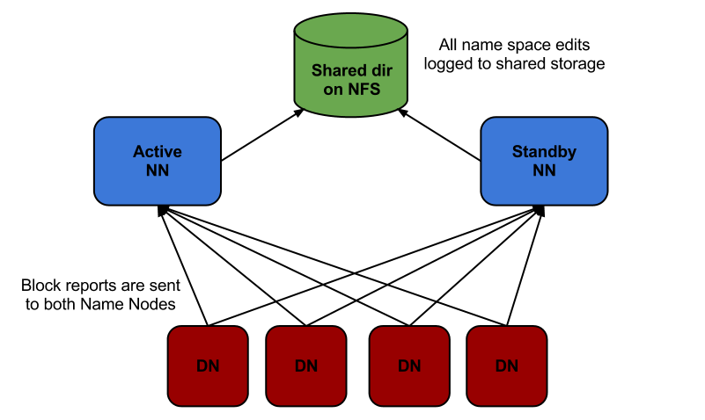
Hdfs Reliability & Scalability
High Availability uses a pair of NameNodes in active–standby mode.
The Active NameNode services client requests.
The Standby NameNode keeps its state synchronized and can take over if the active fails.
HA removes the single point of failure problem by enabling fast failover.
Standby nodes maintain up-to-date metadata so clients experience minimal downtime.
Notes:
https://hdfstutorial.com/blog/hdfs-federation-vs-high-availability/
HDFS High Availability (HA)
Hadoop HA eliminates the Namenode single point of failure using active Standby Namenodes.
Shared edit logs keep metadata synchronized between Namenodes.
ZooKeeper coordinates automatic failover, enabling recovery within seconds instead of long outages
Standby NameNode replaces the Secondary NameNode in Hadoop HA clusters by providing both checkpointing and automatic failover.
Secondary NameNode → restart optimization
Standby NameNode → availability + recovery + checkpointing

Slide 44
Federation vs High Availability
Feature | HDFS Federation | HDFS High Availability
Purpose | Namespace scalability & performance | NameNode fault tolerance & uptime
Number of NameNodes | Multiple independent | Two (Active + Standby)
Relationship | Independent (no sync) | Synchronized metadata
Failure impact | One NameNode fails, others continue | Standby takes over Active
Namespace | Separate for each NameNode | Shared between Active & Standby
Notes:
Federation splits the namespace across multiple NameNodes for scalability.
High Availability ensures no downtime when a NameNode fails by using an active-standby pair.
Both features are part of Hadoop 2.x+ architecture improvements that make HDFS more robust for large clusters.
In a federated HDFS cluster, each NameNode can (and usually should) have its own Standby NameNode.
Federation solves scalability (metadata size & performance).
HA solves availability (no downtime if a NameNode fails).
Without a standby, each federated NameNode would still be a SPOF.

Slide 45
Example
A large enterprise runs an HDFS cluster to store data for multiple departments. To scale metadata management and ensure continuous availability, the cluster is configured with: HDFS Federation, and High Availability (HA)
Cluster Configuration
Total data stored: 12 TB
HDFS block size: 128 MB
Replication factor: 3
Number of NameNodes (Federation): 3
NN1 → /user
NN2 → /logs
NN3 → /analytics
Each namespace stores an equal share of data
Metadata size per block: 150 bytes

Slide 46
Example
Calculate the total number of HDFS blocks in the cluster
Calculate the number of blocks managed by each NameNode
Calculate the NameNode memory required per namespace

Slide 47
Hdfs Performance Optimizations
HDFS Block Caching
HDFS block caching accelerates read performance by keeping frequently accessed blocks in DataNode memory and scheduling computation close to cached data.
By default, HDFS reads data from disk, which is slower than RAM
Block caching stores selected HDFS blocks in DataNode memory
Used for frequently accessed (hot) data
By default, one replica per block is cached (configurable)
NameNode tracks cached blocks and their locations
Notes:
Normally, DataNodes read HDFS blocks from disk, which provides high throughput but has higher latency than memory. For files that are accessed repeatedly (hot data), HDFS allows blocks to be cached in DataNode memory (RAM) to significantly speed up read operations.
Block caching is explicit, meaning users or applications must mark which files should be cached. Once enabled, selected block replicas are loaded into an off-heap memory cache on DataNodes. By default, only one replica of each block is cached, but this can be increased if needed for higher availability or parallel access.
The NameNode manages and tracks caching metadata, including which blocks are cached and on which DataNodes. Job schedulers such as MapReduce and Spark are cache-aware and try to schedule tasks on DataNodes where cached blocks reside, maximizing data locality and improving performance.
Block caching is especially useful for small, frequently accessed datasets, such as lookup tables used in joins or reference data reused across multiple jobs.

Slide 48
Hdfs Performance Optimizations
HDFS Block Caching
Performance Benefits
Job schedulers (Spark, MapReduce) place tasks on DataNodes holding cached blocks.
This eliminates disk I/O and reduces network usage.
Results in significant read performance improvements.
Notes:
Cache Management
Users or applications add cache directives to specify:
Which files to cache
How long they should stay cached
Cache directives are grouped into cache pools for:
Access control
Resource and memory usage management
Typical Use Cases
Lookup tables used in join operations
Reference datasets accessed repeatedly
Hot data shared across multiple jobs

Slide 49
Notes:
Image source: https://data-flair.training/blogs/wp-content/uploads/sites/2/2020/02/hadoop-hdfs-architecture.gif

Slide 50
When HDFS Is Not the Right Choice
Low-latency data access:
HDFS is optimized for high-throughput batch reads, not millisecond-level access, making it unsuitable for real-time applications (HBase is a better fit).
Large numbers of small files:
Managing millions or billions of small files overwhelms the NameNode’s memory, since all file metadata must be stored in RAM.
Multiple writers & random updates:
HDFS only supports single-writer, append-only files and does not allow concurrent writes or arbitrary file modifications.
Notes:
Low-latency data access: Real-time applications such as online transaction processing (OLTP), recommendation engines, and user-facing dashboards require millisecond responses and are better served by systems like HBase.
Large numbers of small files: Applications generating millions of logs, images, IoT sensor files, or email messages perform poorly on HDFS due to NameNode memory constraints.
Because the namenode holds filesystem metadata in memory, the limit to the number of files in a filesystem is governed by the amount of memory on the namenode. As a rule of thumb, each file, directory, and block takes about 150 bytes. So, for example, if you had one million files, each taking one block, you would need at least 300 MB of memory. Although storing millions of files is feasible, billions is beyond the capability of current hardware
Multiple writers & random updates: Collaborative editing systems, financial trading platforms, and applications requiring frequent record updates are not suitable for HDFS because it only supports single-writer, append-only files.
Multiple writers, arbitrary file modifications
Files in HDFS may be written to by a single writer. Writes are always made at the end of the file, in append-only fashion. There is no support for multiple writers or for modifications at arbitrary offsets in the file. (These might be supported in the future, but they are likely to be relatively inefficient.)

